Slide 1


MySQL WHERE clause
In the SELECT statement, the WHERE clause is evaluated after the FROM clause and before the SELECT clause.
Operator | Demo
= | SELECT lastname, firstname, jobtitle FROM employees WHERE jobtitle = 'Sales Rep';
AND | SELECT lastname, firstname, jobtitle, officeCode FROM employees WHERE jobtitle = 'Sales Rep' AND officeCode = 1;
OR | SELECT lastName, firstName, jobTitle, officeCode FROM employees WHERE jobtitle = 'Sales Rep' OR officeCode = 1 ORDER BY officeCode , jobTitle;
BETWEEN | SELECT firstName, lastName, officeCode FROM employees WHERE officeCode BETWEEN 1 AND 3 ORDER BY officeCode; (inclusive>=1 <=3)
LIKE | SELECT firstName, lastName FROM employees WHERE lastName LIKE '%son' ORDER BY firstName;
 | The LIKE operator evaluates to TRUE if a value matches a specified pattern. To form a pattern, you use % and _ wildcards. The % wildcard matches any string of zero or more characters while the _ wildcard matches any single character. This query finds employees whose last names end with the string 'son':

Slide 2
Clauses
Clauses are like the grammar of SQL — they shape the sentence (query) and tell MySQL how to process the data:
- SELECT: Specifies what columns to retrieve.
- WHERE: Filters rows based on conditions.
- GROUP BY: Aggregates rows with common values.
ORDER BY: Sorts the result set.
They don’t return values directly — they structure the query.
https://github.com/mysql/mysql-server/blob/trunk/sql/sql_select.cc

Slide 3
In | The IN operator returns TRUE if a value matches any value in a list. SELECT firstName, lastName, officeCode FROM employees WHERE officeCode IN (1 , 2, 3) ORDER BY officeCode;
Is Null | To check if a value is NULL or not, you use the IS NULL operator, not the equal operator (=). The IS NULL operator returns TRUE if a value is NULL. SELECT lastName, firstName, reportsTo FROM employees WHERE reportsTo IS NULL;
The following table shows the comparison operators that you can use to form the expression in the WHERE clause.
Operator | Description
= | Equal to. You can use it with almost any data types.
<> or != | Not equal to | SELECT lastname, firstname, jobtitle FROM employees WHERE jobtitle <> 'Sales Rep';
< | Less than. You typically use it with numeric and date/time data types. | SELECT lastname, firstname, officeCode FROM employees WHERE officecode > 5;
> | Greater than.
<= | Less than or equal to | SELECT lastname, firstname, officeCode FROM employees WHERE officecode <= 4;
>= | Greater than or equal to

Slide 4
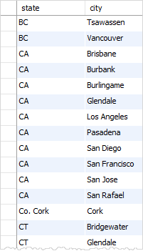
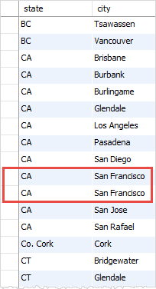
When querying data from a table, you may get duplicate rows. In order to remove these duplicate rows, you use the DISTINCT clause in the SELECT statement.
Q Display lastname from employee table. Ensure it display Unique data.
SELECT DISTINCT lastname FROM employees ORDER BY lastname;
If a column has NULL values and you use the DISTINCT clause for that column, MySQL keeps only one NULL value because DISTINCT treats all NULL values as the same value.
SELECT DISTINCT state, city FROM customers WHERE state IS NOT NULL ORDER BY state, city;
Without the DISTINCT clause, you will get the duplicate combination of state and city as follows:
SELECT state, city FROM customers WHERE state IS NOT NULL ORDER BY state , city;
Q Display state and city from customer table. Ensure it display Unique data.

Slide 5
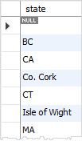

DISTINCT clause vs. GROUP BY clause
Generally speaking, the DISTINCT clause is a special case of the GROUP BY clause.
SELECT state FROM customers GROUP BY state;
SELECT DISTINCT state
FROM customers
ORDER BY state;
SELECT DISTINCT state FROM customers;
Key Differences:
DISTINCT removes duplicate rows but does not perform calculations.
GROUP BY organizes data into groups and allows aggregate functions.
GROUP BY can be used without aggregate functions, but it behaves similarly to DISTINCT in such cases.
SELECT city, COUNT(*) FROM customers GROUP BY city;

Slide 6
You can use the DISTINCT clause with an aggregate function e.g., SUM, AVG, and COUNT, to remove duplicate rows before the aggregate functions are applied to the result set.
COUNT(DISTINCT state): Counts the number of distinct states, meaning duplicates are eliminated. WHERE country = 'USA': Filters records to include only customers located in the USA.
SELECT COUNT(DISTINCT state) FROM customers WHERE country = 'USA';
In case you use the DISTINCT clause with the LIMIT clause, MySQL immediately stops searching when it finds the number of unique rows specified in the LIMIT clause.
SELECT DISTINCT state
FROM customers
WHERE state IS NOT NULL
LIMIT 5;
In how many state of USA my customers are placing order? OR
"What is the total number of unique states where customers reside in the USA?"

Slide 7
Distict and groupby
Purpose & Behavior
Feature DISTINCT GROUP BY
Goal Eliminate duplicate rows Group rows by column(s) and apply aggregation
Usage Simple deduplication Summarization with functions like COUNT, SUM
Syntax SELECT DISTINCT column FROM table; SELECT column, COUNT(*) FROM table GROUP BY column;
Performance Often faster for pure deduplication May be slower due to sorting or aggregation
Flexibility Limited to filtering duplicates Supports complex summaries and filters
🔍 Examples Using DISTINCT
SELECT DISTINCT department FROM employees;
Returns a list of unique departments—no duplicates.
🔍 Examples Using GROUP BY
SELECT department, COUNT(*) FROM employees GROUP BY department;
Returns each department with the number of employees in it.
⚡ Performance Tip
• DISTINCT is generally faster when you're just removing duplicates.
• GROUP BY is better when you need aggregated data (like totals or averages).
• In MySQL, GROUP BY may trigger filesort unless optimized with indexes or ORDER BY NULL.

Slide 8
The AND operator is a logical operator that combines two or more Boolean expressions and returns true only if both expressions evaluate to true. The AND operator returns false if one of the two expressions evaluate to false.
0 means false and 1 means true
The following table illustrates the results of the AND operator when combining true, false, and null.
 | TRUE | FALSE | NULL
TRUE | TRUE | FALSE | NULL
FALSE | FALSE | FALSE | FALSE
NULL | NULL | FALSE | NULL
SELECT customername, country, state FROM customers WHERE country = 'USA' AND state = 'CA';
By using the AND operator, you can combine more than two Boolean expressions
Note that in MySQL, zero is considered false and non-zero is treated as true.
SELECT customername, country, state, creditlimit FROM customers WHERE country = 'USA' AND state = 'CA' AND creditlimit > 100000;
Q display customername, country, state FROM customers where country =USA and state =‘CA’
Q ➔, display the customername, country, state creditlimit from customer table who are locate in California, USA, and have the credit limit greater than 100K.

Slide 9
OR operator combines two Boolean expressions and returns true when either condition is true.
 | TRUE | FALSE | NULL
TRUE | TRUE | TRUE | TRUE
FALSE | TRUE | FALSE | NULL
NULL | TRUE | NULL | NULL
The following table shows the result of the OR operator.
When you use more than one logical operator in an expression, MySQL always evaluates the OR operators after the AND operators. This is called operator precedence which determines the order of evaluation of the operators. MySQL evaluates the operator with higher precedence first.
SELECT (true OR false) AND false;
(true OR false) AND false
-------------------------
0
How it works
First, MySQL evaluates the expression in the parenthesis (true OR false) returns true
Second, MySQL evaluates the remaining part of the statement, true AND false returns false.
See the following example.
SELECT true OR (false AND false);
true OR false AND false
-----------------------
1
How it works
First, MySQL evaluates the AND operator, therefore the expression false AND false returns false.
Second, MySQL evaluates the OR operator hence the expression true OR false returns true.
To change the order of evaluation, you use the parentheses, for example:

Slide 10
For example, to get the customers who locate in the USA or France, you use the OR operator in the WHERE clause as follows:
SELECT
customername,
country
FROM
customers
WHERE country = 'USA' OR
country = 'France';
The following statement returns the customers who locate in the USA or France and have a credit limit greater than 100,000.
SELECT
customername,
country,
creditLimit
FROM
customers
WHERE (country = 'USA'
OR country = 'France')
AND creditlimit > 100000;

Slide 11
The following illustrates the syntax of the IN operator:
Let’s examine the query in more detail:
Use a column or an expression ( expr ) with the IN operator in the WHERE clause.
Separate the values in the list by commas (,).
The IN operator returns 1 if the value of the column_1 or the result of the expression is equal to any value in the list, otherwise, it returns 0.
When the values in the list are all constants, MySQL performs the following steps:
First, evaluate the values based on the type of the column_1 or result of the expr expression.
Second, sort the values.
Third, search for the value using the binary search algorithm. Therefore, a query that uses the IN operator with a list of constants performs very fast.
Note that if the expr or any value in the list is NULL, the IN operator returns NULL.

Slide 12
In and OR
IN vs OR in MySQL
Feature IN Operator OR Operator
Syntax WHERE column IN (val1, val2, val3) WHERE column = val1 OR column = val2 OR ...
Readability More concise and cleaner for multiple values Verbose, especially with many conditions
Performance Often faster due to internal binary search May be slower—evaluates each condition separately
Optimization Easier for the query planner to optimize Depends on engine’s ability to rewrite as IN
Use Case Best for checking against a list of constants Useful when comparing different columns or logic
Example Comparison Using IN
SELECT * FROM employees WHERE department IN ('Sales', 'HR', 'IT’);
Example Comparison Using OR
SELECT * FROM employees WHERE department = 'Sales' OR department = 'HR' OR department = 'IT’;
Both return the same result—but IN is cleaner and often more efficient, especially with large lists.
⚠️ When to Use OR Instead
Use OR when:
• You're comparing different columns: WHERE city = 'Mumbai' OR state = 'MH’
• You need complex conditions:WHERE salary > 80000 OR title LIKE '%Manager%'

Slide 13
In Examples
You can achieve the same result with the OR operator as the following query:
SELECT
officeCode,
city,
phone
FROM
offices
WHERE
country = 'USA' OR country = 'France';
If you want to find officeCode, city, phone,
country from offices table that locate in the country U.S. or France, you can use the IN operator as the following query:
SELECT
officeCode,
city,
phone,
country
FROM
offices
WHERE
country IN ('USA' , 'France');
In case the list has many values, you need to construct a very long statement with multiple OR operators. Hence, the IN operator allows you to shorten the query and make it more readable.
Key Differences:
Readability: IN is cleaner when checking multiple values.
Performance: IN can be optimized better by MySQL, especially with indexed columns.
Flexibility: OR allows combining different conditions (e.g., price > 100 OR stock < 50), while IN is limited to checking values in a list.

Slide 14
Between and AND
Syntax: SELECT * FROM employees WHERE salary BETWEEN 50000 AND 80000;
Meaning: This checks if salary is greater than or equal to 50000 and less than or equal to 80000.
Equivalent AND Version: SELECT * FROM employees WHERE salary >= 50000 AND salary <= 80000;
⚖️ Comparison Table
Feature BETWEEN ... AND >= ... AND <=
Readability More concise for range checks Slightly more verbose
Inclusivity Includes both boundary values Same (if written correctly)
Flexibility Limited to one column per range Can mix conditions across columns
Functionality Internally treated as two comparisons Explicitly shows both comparisons
🧠 Example with Dates
-- Using BETWEEN SELECT * FROM orders WHERE order_date BETWEEN '2024-01-01' AND '2024-01-31’;
-- Using AND SELECT * FROM orders WHERE order_date >= '2024-01-01' AND order_date <= '2024-01-31';
Both return orders placed in January 2024, including the start and end dates.
🧪 When to Prefer One Over the Other
• Use BETWEEN for clean range filters on a single column.
• Use AND when comparing multiple columns or when you need more control over inclusivity/exclusivity.

Slide 15
Using MySQL LIKE with the percentage (%) wildcard
This example uses the LIKE operator to find employees whose first names start with a:
SELECT
employeeNumber,
lastName,
firstName
FROM
employees
WHERE
firstName LIKE 'a%';
This example uses the LIKE operator to find employees whose last names end with on e.g., Patterson, Thompson:
SELECT
employeeNumber,
lastName,
firstName
FROM
employees
WHERE
lastName LIKE '%on';
To find employees whose first names start with T , end with m, and contain any single character between e.g., Tom , Tim, you use the underscore (_) wildcard to construct the pattern as follows:
SELECT
employeeNumber,
lastName,
firstName
FROM
employees
WHERE
firstname LIKE 'T_m';
If you know the searched string is embedded inside in the middle of a string, you can use the percentage ( % ) wildcard at the beginning and the end of the pattern.
For example, to find all employees whose last names contain on , you use the following query with the pattern %on%
SELECT
employeeNumber,
lastName,
firstName
FROM
employees
WHERE
lastname LIKE '%on%';

Slide 16
The MySQL allows you to combine the NOT operator with the LIKE operator to find a string that does not match a specific pattern.
Suppose you want to search for employees whose last names don’t start with the character B, you can use the NOT LIKE with a pattern as shown in the following query:
SELECT
employeeNumber,
lastName,
firstName
FROM
employees
WHERE
lastName NOT LIKE 'B%';
Sometimes the pattern, which you want to match, contains wildcard character e.g., 10%, _20, etc. In this case, you can use the ESCAPE clause to specify the escape character so that MySQL will interpret the wildcard character as a literal character. If you don’t specify the escape character explicitly, the backslash character \ is the default escape character.
For example, if you want to find products whose product codes contain the string _20 , you can use the pattern %\_20% as shown in the following query:
SELECT
productCode,
productName
FROM
products
WHERE
productCode LIKE '%\_20%
Or you can specify a different escape character e.g., $ by using the ESCAPE clause:
SELECT productCode, productName
FROM products
WHERE
productCode LIKE '%$_20%' ESCAPE ‘$’;
The pattern %$_20% matches any string that contains the _20 string.

Slide 17
CREATE TABLE myemployee ( emp_id INT AUTO_INCREMENT, name VARCHAR(100), pincode VARCHAR(100), PRIMARY KEY (emp_id));
insert into myemployee (name, pincode)values('raj',400056), ('Mona_n',400055), ('geeta_t',400057), ('mona_n',400057), ('Mona_nn',400059),
('_raja',400096), ('_kavi',400088);
Display all name starting with _(Underscore)

Slide 18
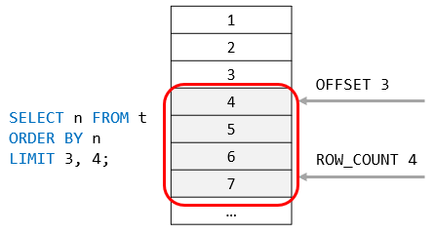
The LIMIT clause is used in the SELECT statement to constrain the number of rows to return. The LIMIT clause accepts one or two arguments. The values of both arguments must be zero or positive integers.
The following illustrates the LIMIT clause syntax with two arguments:
SELECT
select_list
FROM
table_name
LIMIT [offset,] row_count;
In this syntax:
The offset specifies the offset of the first row to return. The offset of the first row is 0, not 1.
The row_count specifies the maximum number of rows to return.
The following picture illustrates the LIMIT clause:
When you use the LIMIT clause with one argument, MySQL will use this argument to determine the maximum number of rows to return from the first row of the result set.
Therefore, these two clauses are equivalent:
LIMIT row_count;
And
LIMIT 0 , row_count;
0
1
2
3
4
5
6
7

Slide 19
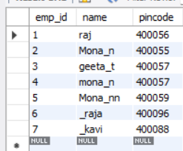

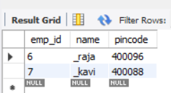
select * from myemployee order by emp_id;
select * from myemployee order by emp_id limit 3,2;
select * from myemployee order by emp_id limit 5,2;

Slide 20

LIMIT and ORDER BY clauses
The SELECT statement without an ORDER BY clause returns rows in an unspecified order. It means that rows can be in any order. When you apply the LIMIT clause to this unordered result set, you will not know which rows the query will return.
For example, you may want to get fifth through tenth rows, but fifth through tenth in what order? The order of rows is unknown unless you specify the ORDER BY clause.
Therefore, it is a good practice to always use the LIMIT clause with the ORDER BY clause to constraint the result rows in unique order.
SELECT select_list
FROM table_name
ORDER BY order_expression
LIMIT offset, row_count;
The following picture illustrates the evaluation order of the LIMIT clause in the SELECT statement:
MySQL LIMIT Evaluation Order

Slide 21
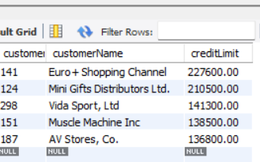
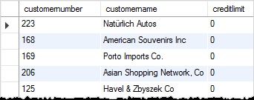
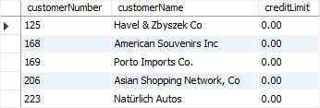
Using MySQL LIMIT to get the highest or lowest rows
This statement uses the LIMIT clause to get the top five customers who have the highest credit:
SELECT
customerNumber,
customerName,
creditLimit
FROM
customers
ORDER BY creditLimit DESC
LIMIT 5;
in this example:
First, the ORDER BY clause sorts the customers by credits in high to low.
Then, the LIMIT clause returns the first 5 rows.
Similarly, this example uses the LIMIT clause to find 5 customers who have the lowest credits:
SELECT
customerNumber,
customerName,
creditLimit
FROM
customers
ORDER BY creditLimit
LIMIT 5;
In this example:
First, the ORDER BY clause sorts the customers by credits in low to high.
Then, the LIMIT clause returns the first 5 rows
Customernumbr not sorted
Because there are more than 5 customers that have credits zero, the result of the query above may lead to an inconsistent result. To fix this the issue, you need to add more column to the ORDER BY clause to constrain the row in unique order
SELECT customerNumber, customerName, creditLimit FROM customers ORDER BY creditLimit, customerNumber LIMIT 5;

Slide 22
2) Using MySQL LIMIT for pagination
This query uses the LIMIT clause to get the rows of the second page that include row 11 – 20:
SELECT customerNumber, customerName
FROM customers
ORDER BY customerName
LIMIT 10, 10;
In this example, the clause LIMIT 10, 10 returns 10 rows for the row 11 – 20.
When you display data on applications, you often want to divide rows into pages, where each page contains a certain number of rows like 5, 10, or 20.
To calculate the number of pages, you get the total rows divided by the number of rows per page. For fetching rows of a specific page, you can use the LIMIT clause.
This query uses the COUNT(*) aggregate function to get the total rows from the customers table:
SELECT COUNT(*) FROM customers;
+----------+
| COUNT(*) |
+----------+
| 122 |
+----------+
1 row in set (0.00 sec)
Suppose that each page has 10 rows, to display 122 customers you have 13 pages. The last 13th page contains two rows only.
This query uses the LIMIT clause to get rows of page 1 which contains the first 10 customers sorted by the customer name:
SELECT customerNumber, customerName
FROM customers
ORDER BY customerName
LIMIT 10;

Slide 23
Using MySQL LIMIT to get the nth highest or lowest value
SELECT select_list
FROM table_name
ORDER BY sort_expression
LIMIT n-1, 1;
The clause LIMIT n-1, 1 returns 1 row starting at the row n.
For example, the following finds the customer who has the second-highest credit:
SELECT customerName, creditLimit
FROM customers
ORDER BY creditLimit DESC
LIMIT 1,1;
Note that this technique works when there are no two customers who have the same credit limits. To get a more accurate result, you should use the DENSE_RANK() window function.

Slide 24
Refer PPT
02rank dense rank rownumber heighest sal

Slide 25
DENSE_RANK function
The DENSE_RANK() is a window function that assigns a rank to each row within a partition or result set with no gaps in ranking values.
The rank of a row is increased by one from the number of distinct rank values which come before the row.
The syntax of the DENSE_RANK() function is as follows:
DENSE_RANK() OVER (
PARTITION BY <expression>[{,<expression>...}]
ORDER BY <expression> [ASC|DESC], [{,<expression>...}]
)
In this syntax:
First, the PARTITION BY clause divides the result sets produced by the FROM clause into partitions. The DENSE_RANK() function is applied to each partition.
Second, the ORDER BY clause specifies the order of rows in each partition on which the DENSE_RANK() function operates.
If a partition has two or more rows with the same rank value, each of these rows will be assigned the same rank.

Slide 26
CREATE TABLE sales(
sales_employee VARCHAR(50) NOT NULL,
fiscal_year INT NOT NULL,
sale DECIMAL(14,2) NOT NULL,
PRIMARY KEY(sales_employee,fiscal_year)
);
INSERT INTO sales(sales_employee,fiscal_year,sale)
VALUES('Bob',2016,100),
('Bob',2017,150),
('Bob',2018,200),
('Alice',2016,150),
('Alice',2017,100),
('Alice',2018,200),
('John',2016,200),
('John',2017,150),
('John',2018,250);
SELECT * FROM sales;

Slide 27
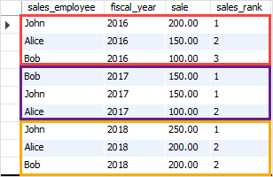
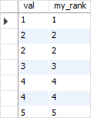
Suppose we have a table t with some samples data as follows:
CREATE TABLE t (
val INT
);
INSERT INTO t(val)
VALUES(1),(2),(2),(3),(4),(4),(5);
SELECT *
FROM t;
The following statement uses the DENSE_RANK() function to assign a rank to each row:
SELECT val,
DENSE_RANK() OVER ( ORDER BY val ) my_rank
FROM t;
Here is the output:
We will discuss it later
The following statement uses the DENSE_RANK() function to rank the sales employees by sale amount.
SELECT
sales_employee, fiscal_year, sale,
DENSE_RANK() OVER (PARTITION BY
fiscal_year
ORDER BY
sale DESC
) sales_rank
FROM
sales;
In this example:
First, the PARTITION BY clause divided the result sets into partitions using fiscal year.
Second, the ORDER BY clause specified the order of the sales employees by sales in descending order.
Third, the DENSE_RANK() function is applied to each partition with the rows order specified by the ORDER BY clause.

Slide 28
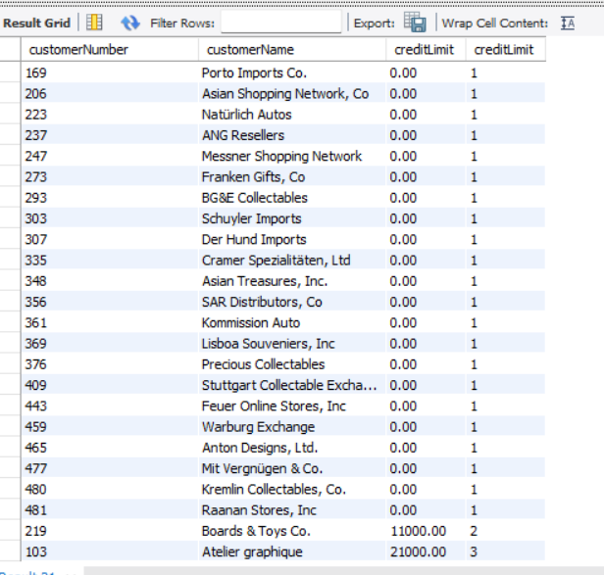
Give rank to credit limit in asce. order
SELECT customerNumber, customerName, creditLimit, DENSE_RANK() OVER ( ORDER BY creditLimit ) creditLimit FROM customers ORDER BY creditLimit , customerNumber LIMIT 0,26;

Slide 29
Finding Nth highest salary in a table is the most common question asked in interviews. Here is a way to do this task using dense_rank() function.
CREATE TABLE emp (
ename varchar(255),
sal INT
);
ename sal
A 23000
B 31000
C 24500
D 35000
E 28500
F 31500
G 39800
H 51000
I 39800
select * from(select ename, sal, dense_rank() over(order by sal desc)r from emp) AS ranked_employees where r=2;
To find to the 2nd highest sal set n = 2
To find 3rd highest sal set n = 3 and so on.
This is name of virtual table
INSERT INTO emp (ename, sal) VALUES('A', 23000),('B', 31000),('C', 24500),('D', 35000),('E', 28500),('F', 31500),('G', 39800),('H', 51000),('I', 39800);
TOP 5 Salary
select * from(select ename, sal, dense_rank() over(order by sal desc)r from emp) AS ranked_employees where r<=5;
DENSE_RANK :
DENSE_RANK computes the rank of a row in an ordered group of rows and returns the rank as a NUMBER. The ranks are consecutive integers beginning with 1.
This function accepts arguments as any numeric data type and returns NUMBER.
As an analytic function, DENSE_RANK computes the rank of each row returned from a query with respect to the other rows, based on the values of the value_exprs in the order_by_clause.
In the above query the rank is returned based on sal of the employee table. In case of tie, it assigns equal rank to all the rows.

Slide 30
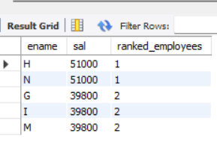
With Limit key word
select ename, sal, dense_rank() over(order by sal desc) AS ranked_employees from emp order by sal desc LIMIT 0,5;

Slide 31
select * from(select ename, sal, dense_rank() over(order by sal desc)r from emp) AS ranked_employees where r=2;
Step 1.
SELECT ename, sal, DENSE_RANK() OVER (ORDER BY sal DESC) r FROM emp
Step 2.
Outer Query
SELECT * FROM (...) WHERE r = 2;
- ename, sal: Selects employee name and salary.
- DENSE_RANK() OVER (ORDER BY sal DESC): Assigns ranks based on salary in descending order.
- Highest salary → Rank 1
- If two employees share the same salary, they receive the same rank.
- No gaps between ranks (unlike RANK()).
Example Output of Subquery:
| ename | sal | r |
|--------- |------ - |---|
| Alice | 90000 | 1 |
| Bob | 90000 | 1 |
| Charlie | 85000 | 2 |
| David | 80000 | 3 |
- Filters the result to only include rows where the rank r = 2, i.e., employees with the second highest salary.
Expected Final Output:
| ename | sal | r |
|---------|-------|---|
| Charlie | 85000 | 2 |

